Slide 1
Predicate Logic
INT404

Slide 2
A Predicate Logic Example
Marcus was a man.
Marcus was a Pompeian.
All Pompeian were Romans.
Caesar was a ruler.
All Romans were either loyal to Caesar or hated him.
Everyone is loyal to someone.
People only try to assassinate rulers they are not loyal to.
Marcus tried to assassinate Caesar.

Slide 3
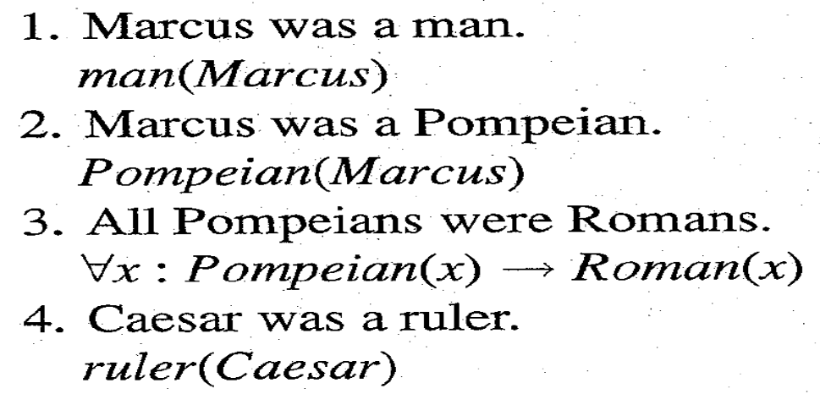
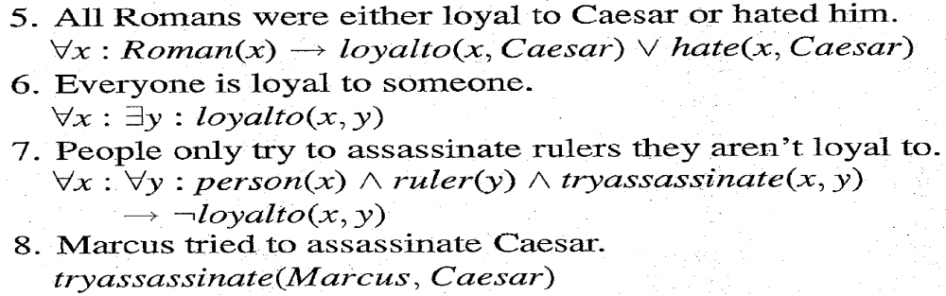
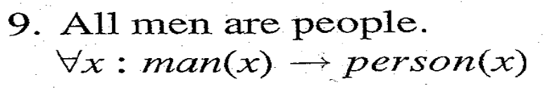
A Predicate Logic Example

Slide 4
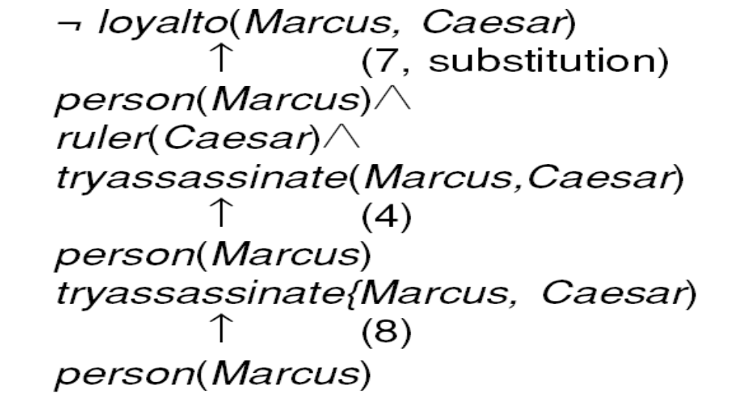





An Attempt to Prove

Slide 5
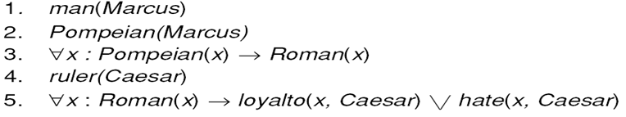
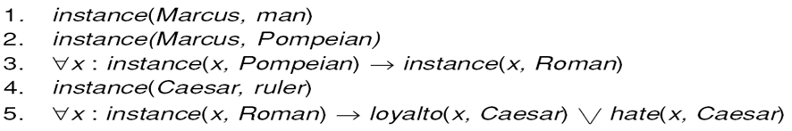
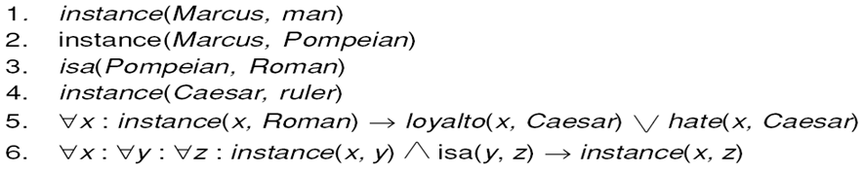
Three Ways of Representing
Class Membership

Slide 6
Overriding Defaults
Make Paulus an exception to the general rule about the
Romans and their feeling towards Caesar.
Suppose we add:
But now we have a problem with 5:
So we need to change it to :
Every exception to a general rule must be stated twice, once in a particular statement
And once in exception list that forms part of general rule

Slide 7
Another Predicate Logic Example
Marcus was a man.
Marcus was a Pompeian.
Marcus was born in 40 A.D.
All men are mortal.
All Pompeians died when the volcano erupted in 79 A.D.
No mortal lives longer than 150 years.
It is now 1991.
Is Marcus alive?
Alive means not dead.
If someone dies, then he is dead at all later times.

Slide 8
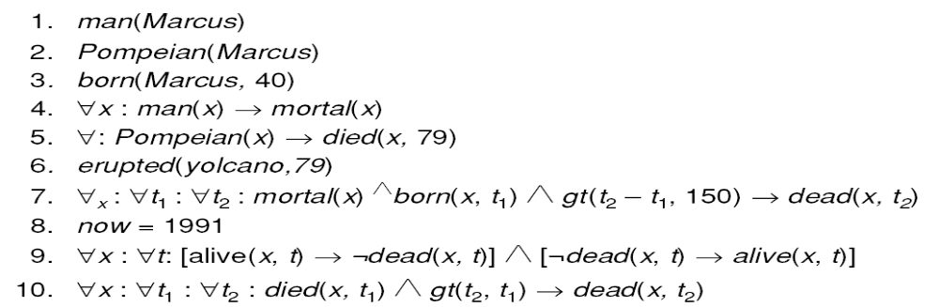
A Set of Facts about Marcus
Computable predicates

Slide 9
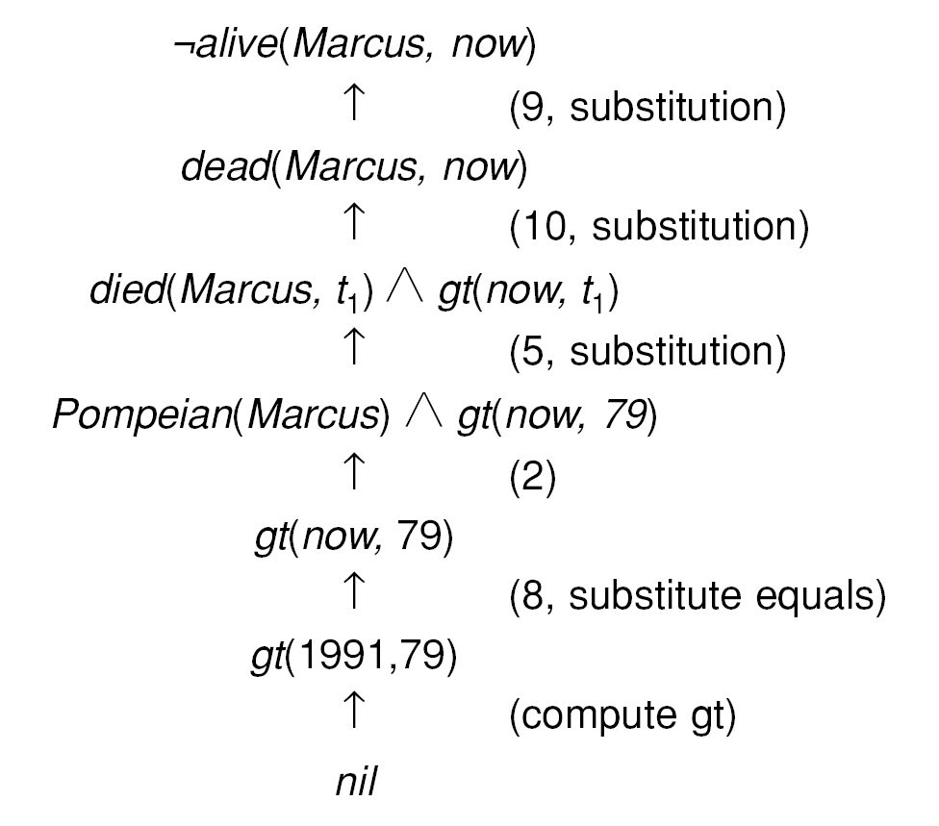
One Way of Proving That Marcus Is Dead
The term nil at end of each proof indicate that the list of conditions remaining is empty
So the proof has succeeded.

Slide 10
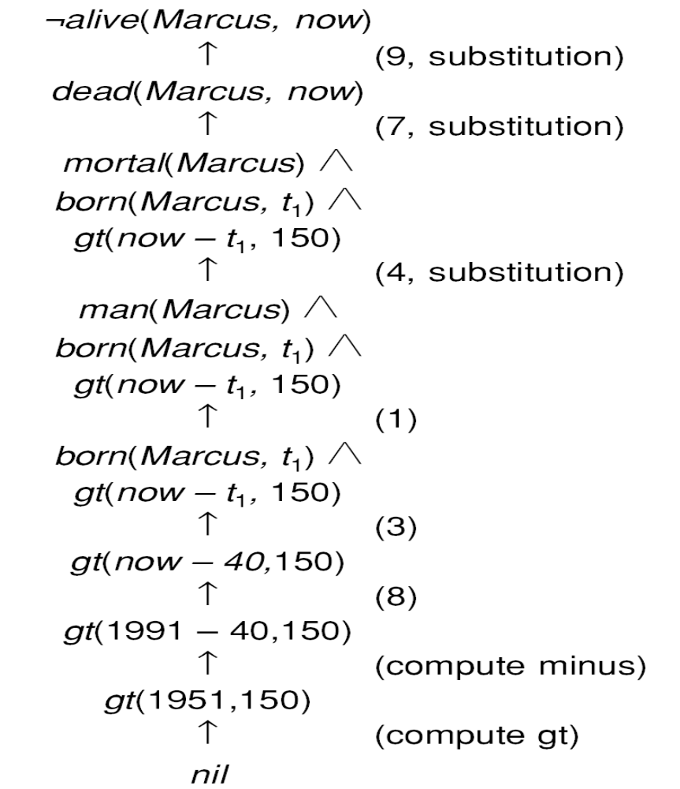
Another Way of Proving That Marcus Is Dead
Very simple conclusion can
require many steps to prove.
A variety of processes such as
Matching, substitution and application
of modus ponens are involved in
production of proof.

Slide 11
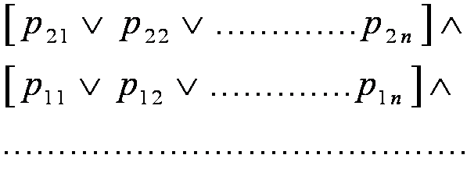
Resolution
Resolution produces proof by refutation. i.e. to prove a statement, resolution attempts to show that the negation of statement produces a contradiction with known statements.
This approach contrast with technique that we have been using to generate proofs by chaining backward from theorem to be proved axioms.
It operates on statements that have been converted to a very convenient standard form.
The formula would be easier to work with if
  It were flatter i.e. there was less embedding of components.
  The quantifiers were separated from the rest of formula so they did not need to be consider.
Conjunctive Normal Form (CNF)has both these properties.

Slide 12
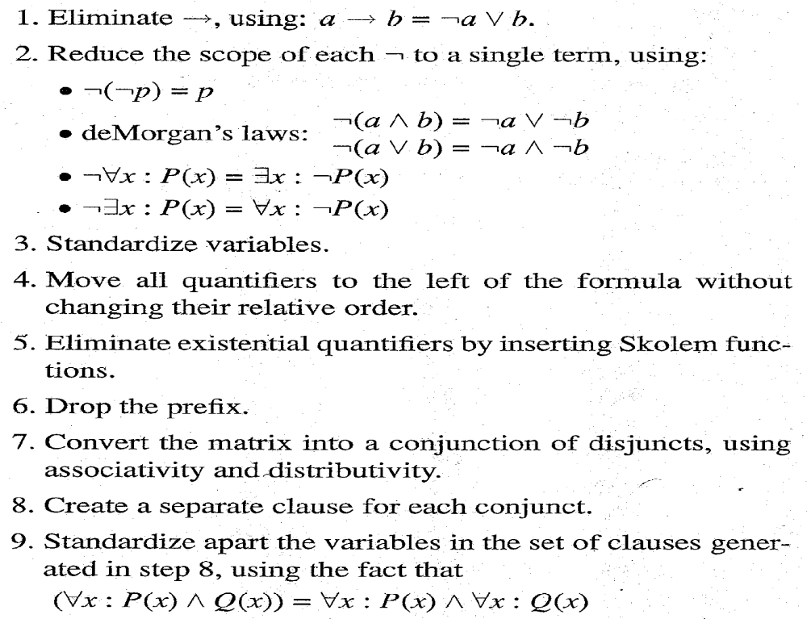
Algorithm : Convert to Clause Form

Slide 13
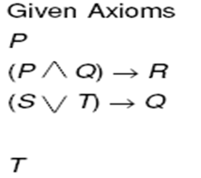
Examples of Conversion to Clause Form

Slide 14
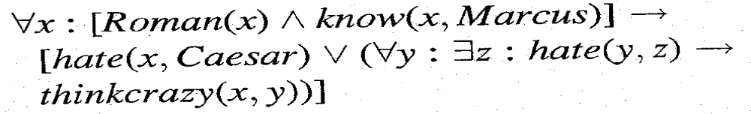


Examples of Conversion to Clause Form
Suppose we know that all Romans who know Marcus either hate Caesar or think
That anyone who hates anyone is crazy.
Example :
1 Eliminate 
2 Reduce scope of
3 Standardize Variables.

Slide 15





Examples of Conversion to Clause Form
4 Move quantifiers.
Prenex normal form
5 Eliminate existential quantifiers.
will be converted to
while
will be converted to
6 Drop the prefix.
7 Convert to a conjunction of disjuncts.

Slide 16
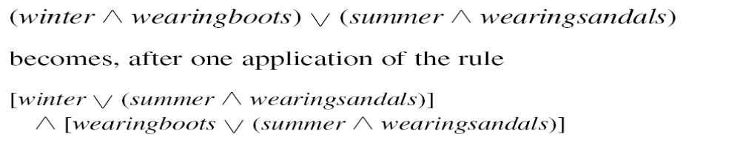
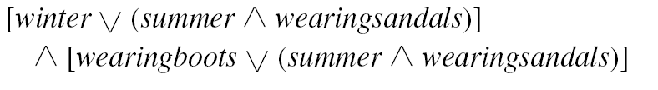
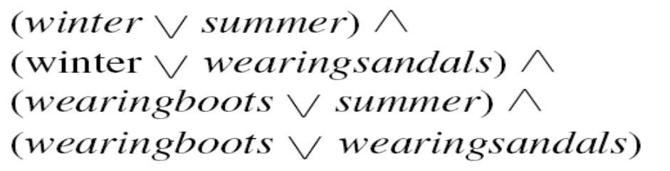
Convert a matrix to conjunction of disjuncts.
The Formula
becomes
and then becomes

Slide 17
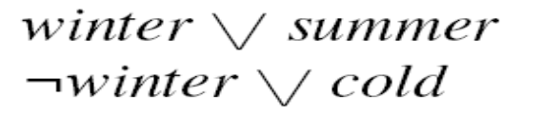

The Basis of Resolution
Given :
Parent clauses
becomes
Resulting clause: resolvent
116

Slide 18
Herbrand’s Theorem
• To show that a set of clauses S is unsatisfiable, it is necessary to consider only interpretations over a particular set, called the Herbrand universe of S.
• A set of clauses S is unsatisfiable if and only if a finite subset of ground instances (in which all bound variables have had a value substituted for them) of S is unsatisfiable.
117

Slide 19
Algorithm : Propositional Resolution
Assume that , a set of given statement F and a statement to be proved P:
Convert all the propositions of F to clause form.
2. Negate P and convert the result to clause form. Add it to the set of clauses obtained in step 1.
3. Repeat until either a contradiction is found or no progress can be made:
Select two clauses. Call these the parent clauses.
(b) Resolve them together. The resulting clause, called the resolvent, will be the disjunction of all of the literals of both of the parent clauses with the following exception: If there are any pairs of literals L and ¬L such that one of the parent clauses contains L and the other contains ¬L, then select one such pair and eliminate both L and ¬L from the resolvent.
(c) If the resolvent is the empty clause, then a contradiction has been found. If it is not, then add it to the set of clauses available to the procedure.
118

Slide 20
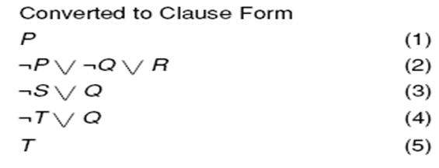

A Few Facts in Propositional Logic
We have to prove R
119

Slide 21
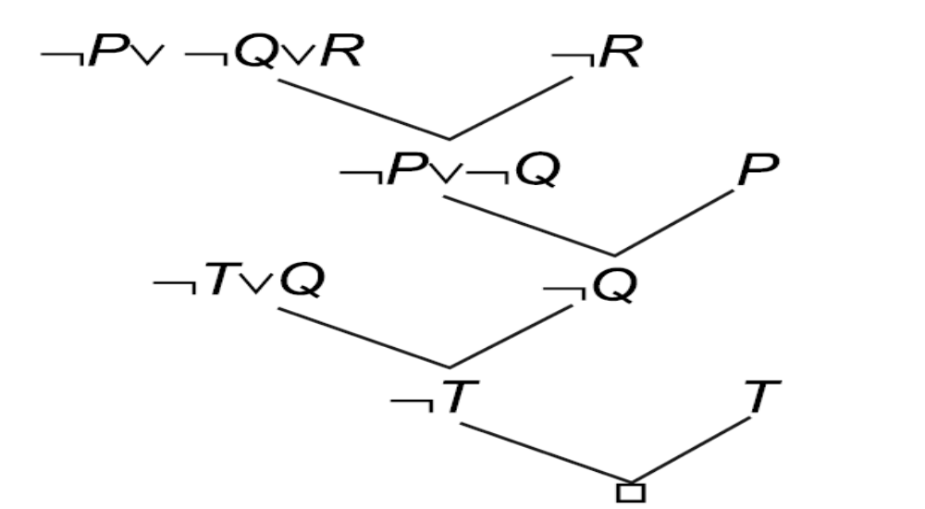
Resolution in Propositional Logic
120

Slide 22
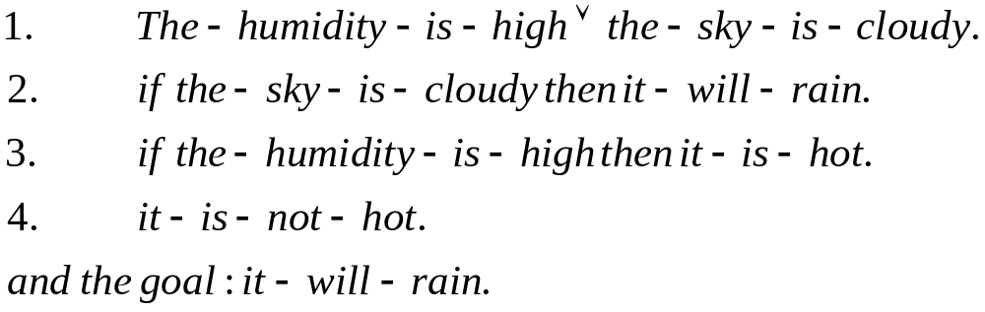
Example
Consider the following knowledge base:
Prove by resolution theorem that the goal is derivable from the knowledge base.

Slide 23
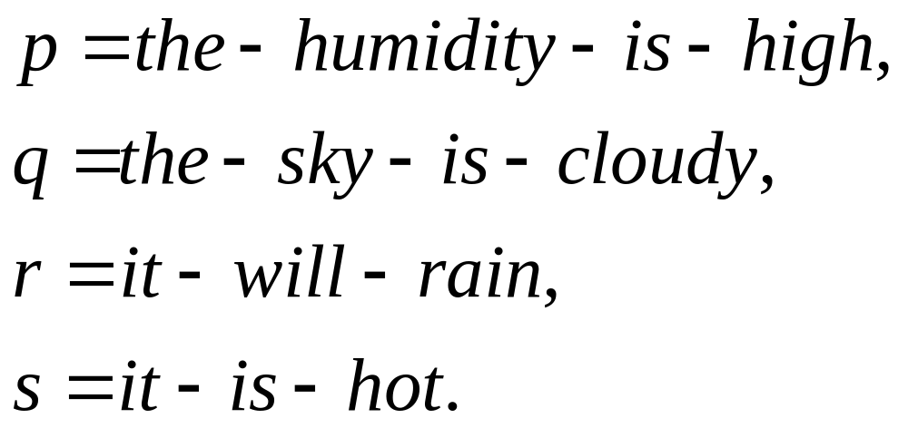
Example
Proof:
Let us first denote the above clauses by the following symbols.

Slide 24
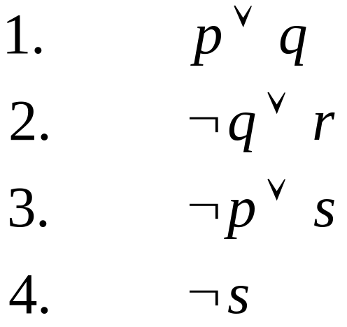

Example
The CNF form of the above clauses thus become
and the negated goal Set S thus includes all these 5 clauses.

Slide 25
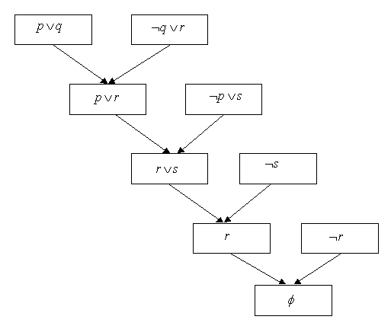
Fig. 5.3: The resolution tree to prove that it-will-rain.

Slide 26
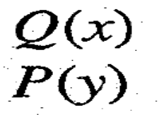

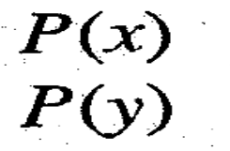

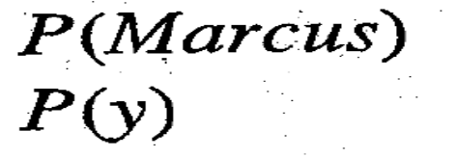

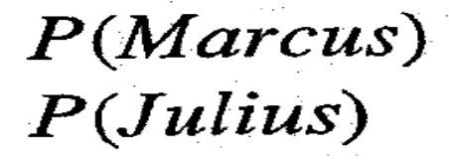
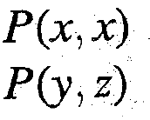
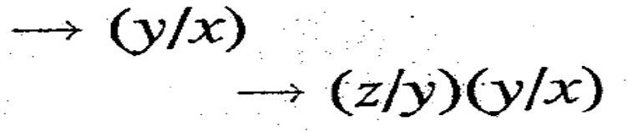

Unification
121

Slide 27
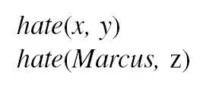
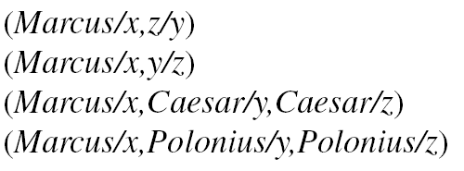
Finding General Substitutions
Given :
We could produce :
122

Slide 28
Algorithm : Unify (L1, L2)
If L1 or L2 are both variables or constants, then:
(a) If L1 and L2 are identical, then return NIL.
(b) Else if L1 is a variable, then if L1 occurs in L2 then return {FAIL}, else return (L2/L1).
(c) Else if L2 is a variable then if L2 occurs in L1 then return {FAIL}, else return (L1/L2).
(d) Else return {FAIL}.
2. If the initial predicate symbols in L1 and L2 are not identical, then return {FAIL).
3. If LI and L2 have a different number of arguments, then return {FAIL}.
4. Set SUBST to NIL.
5. For i ← 1 to number of arguments in L1:
(a) Call Unify with the /th argument of L1 and the ith argument of L2, putting result in S.
(b) If S contains FAIL then return {FAIL}.
(c) If S is not equal to NIL then:
(i) Apply S to the remainder of both L1 and L2.
(ii) SUBST : = APPEND(S, SUBST).
6. Return SUBST.
123

Slide 29
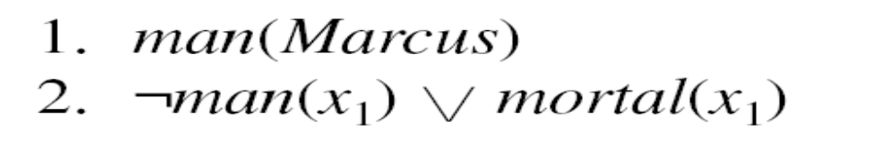
Resolution in Predicate Logic
Example :
Yield the substitution :
Marcus/x₁
So it does not yield the resolvent :
Mortal(x₁)
It does yield :
mortal(Marcus)
125

Slide 30
Algorithm : Resolution
1. Convert all the statements of F to clause form.
2. Negate P and convert the result to clause form. Add it to the set of clauses obtained in 1.
3. Repeat until either a contradiction is found, no progress can be made, or a predetermined amount of effort has been expended.
Select two clauses. Call these the parent clauses.
Resolve them together. The resolvent will be the disjunction of all the literals of both parent clauses with appropriate substitutions performed and with the following exception: If there is one pair of literals T1 and ¬T2 such that one of the parent clauses contains T2 and the other contains T1 and if T1 and T2 are unifiable, then neither T1 nor T2 should appear in the resolvent. If there is more than one pair of complimentary literals, only one pair shold be omitted from the resolvent.
If the resolvent is the empty clause, then a contradiction has been found. If it is not, then add it to the set of clauses available to the procedure.
126

Slide 31
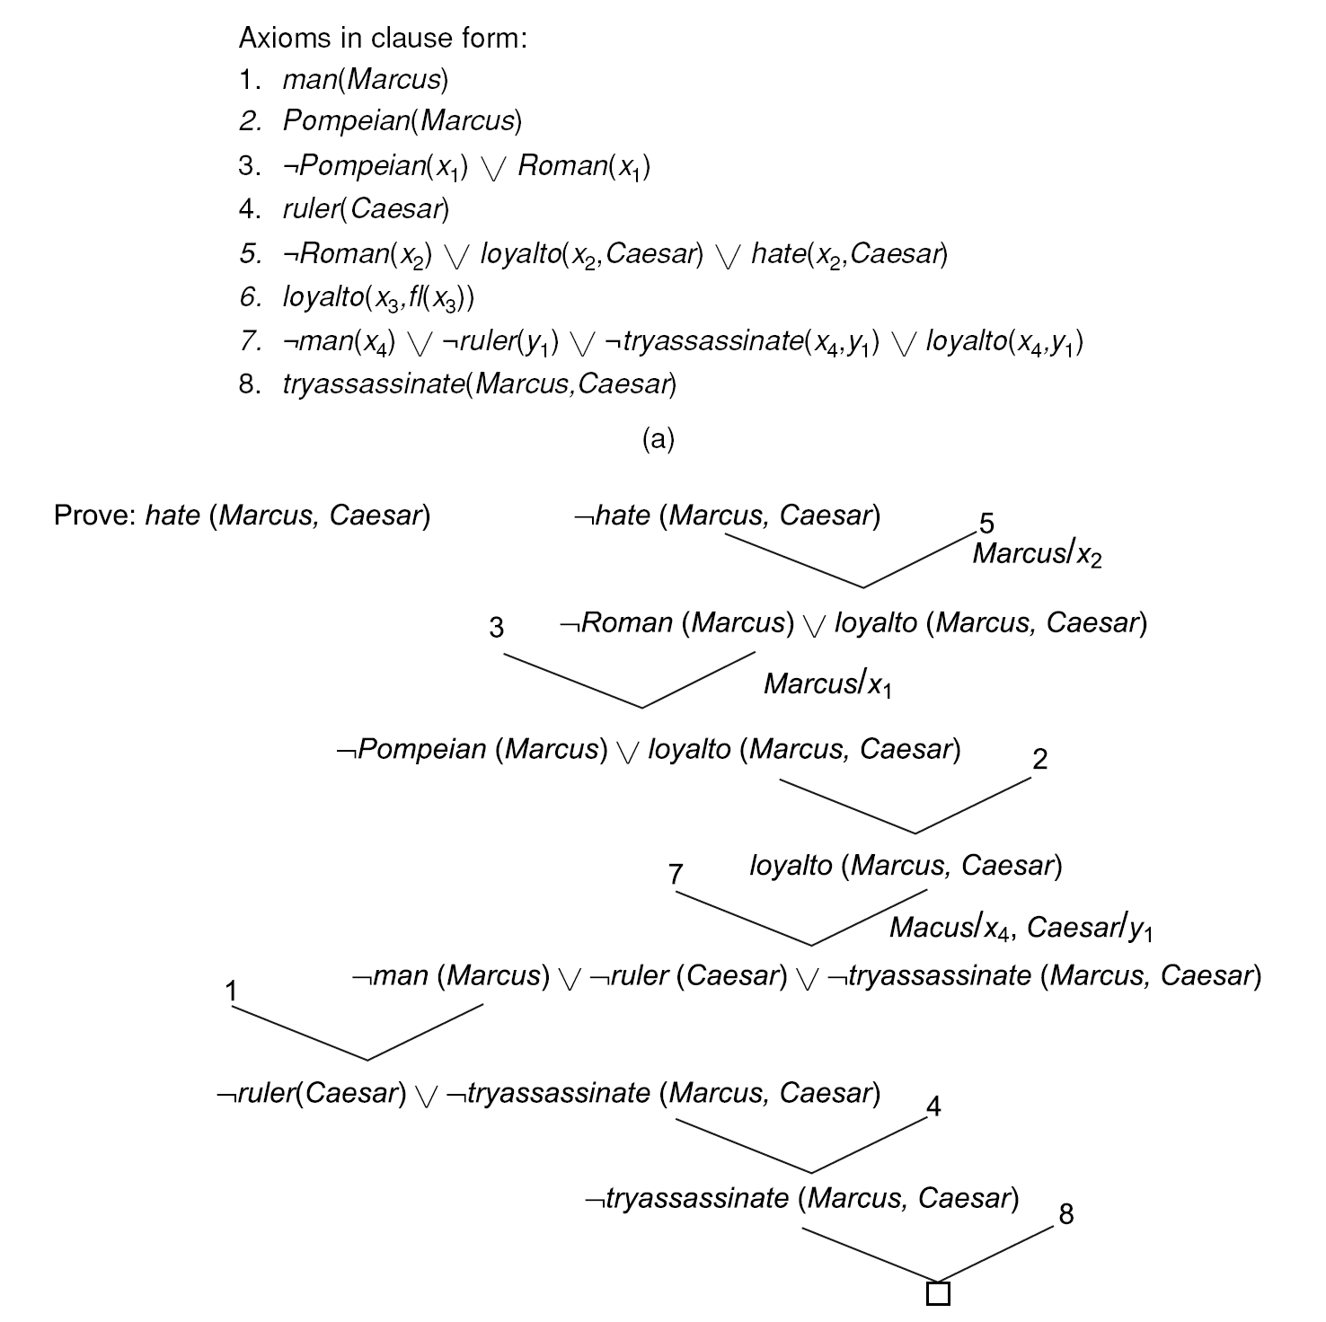
A Resolution Proof
127

Slide 32
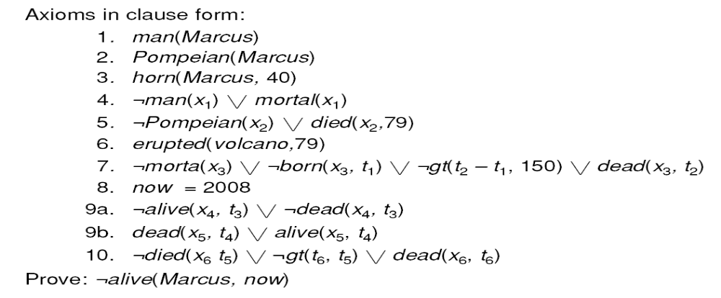
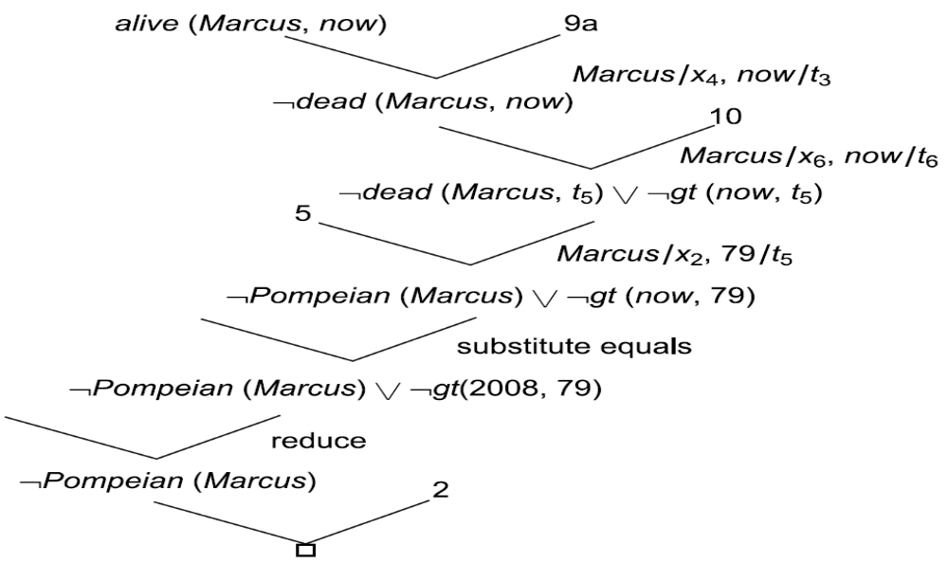
Using Resolution with Equality and Reduce
130

Slide 33


